Slide 1
Gesture recognition using smart watch
--progress report
Steven Wang

Slide 2
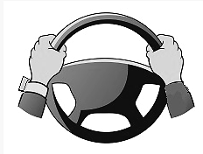
Project introduction
Allow a driver wearing a smart watch to use wrist and hand gestures to navigate through a watch app while keeping the watch bearing hand on the steering wheel.
Single / double outside rotation
Single / double inside rotation
Grip gesture

Slide 3
Current status
Current status:
Free hand gesture classification
Single outside
Single inside
Double outside
Double inside
Grip
Simple implementation using SDL

Slide 4
System flow chart
Raw data collection
Data processing
Data processing
Extract statistic features
Extract required features
Error analysis
Correlation analysis
Testing
Build classifier
Training

Slide 5
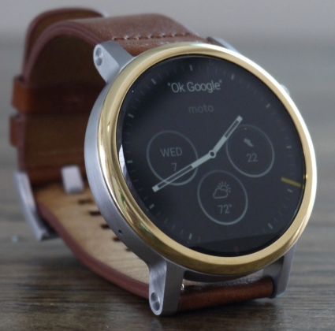
Data collection
Linear Accelerometer
The linear acceleration sensor provides a three dimensional vector representing acceleration along each device axis, excluding gravity
Gyroscope
The gyroscope measures the rate of rotation in rad/s (angular speed) around a device’s x, y, and z axis.
y
x
z

Slide 6
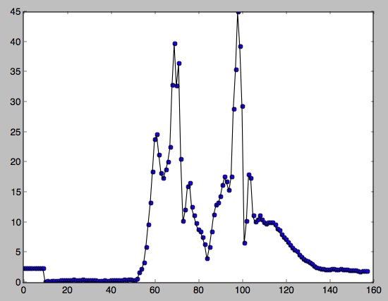
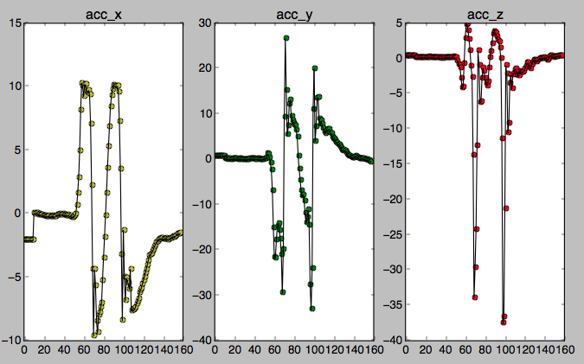
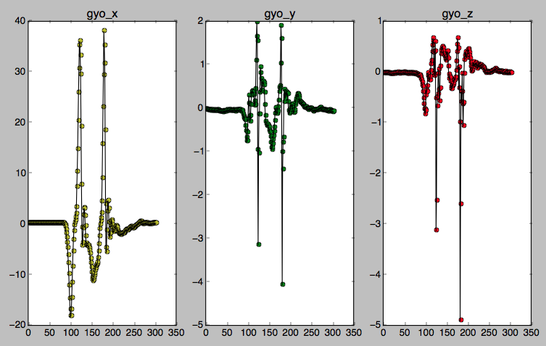
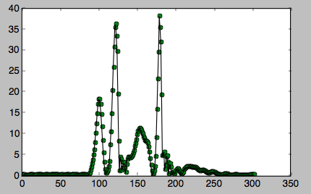
Data visualization – double inside
sqrt(acc_x² + acc_y ² + acc_z²)
acc magnitude
Sqrt(gro_x² + gro_y ² + gro_z²)
gro magnitude

Slide 7
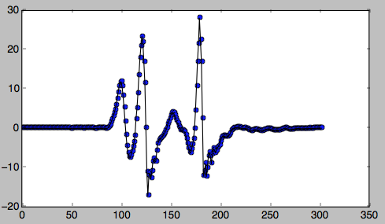
Relative angular speed
Define:
Set the angular speed magnitude at the first point as the speed reference value, label as as₀
Label the relative angular speed at n^{th} point as rAs_{n}. Label the angular speed magnitude at n^{th} point as as_{n}
rAs_{n} = as_{n} – as₀
Formula:
as_{last} = as_{current}
as_{current}= sqrt(gro_x² + gro_y ² + gro_z²)
delta = as_{current}- as_{last}
rAs_{n} = rAs_{n-1} * 0.9 + delta
Double inside gro_magnitude
Double inside rAs

Slide 8
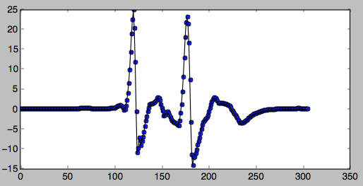
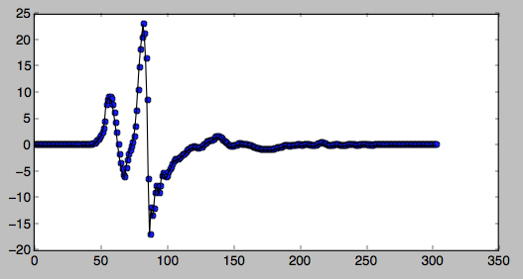
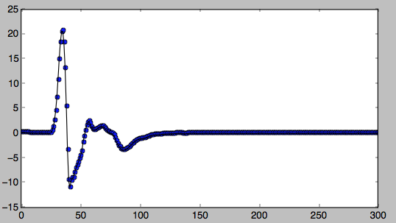
Plot of relative angle speed
double inside
double outside
single inside
single outside

Slide 9
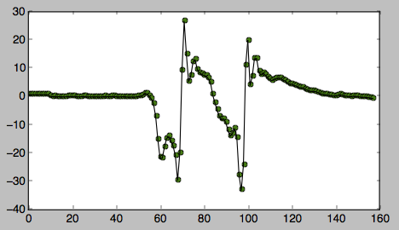
Event trigger and feature extraction
Relative angular speed
Algorithm:
rAs_{arr}=[] accY_{arr}=[] timer initial
trigger = false
if rAs>triggerThreshold and !trigger: trigger = true
timer start for 1 data chunk period:
rAs_{arr}.append(rAs) accY_{arr}.append(accY) timer reset
trigger = false
Trigger threshold
Data chunk period
acc_y
Time sync with rAs

Slide 10
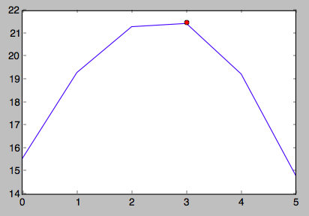
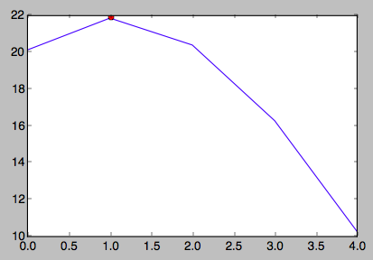
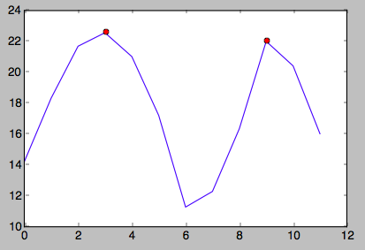
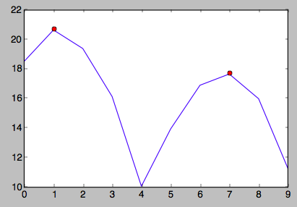
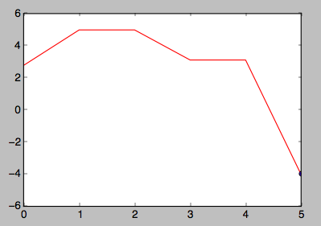
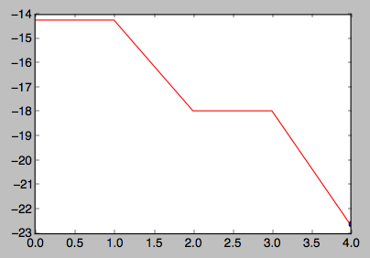
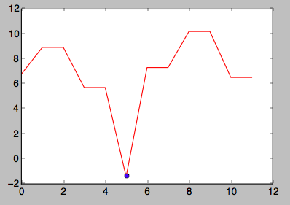
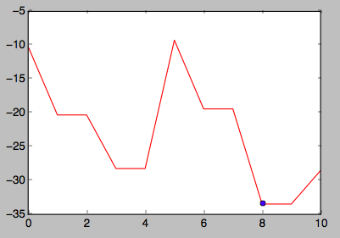
Feature extraction
peak_{arr}=[]
for i in range1,len(rAs_{arr}): if rAs_{arr}[i]>rAs_{arr}[i-1] and rAs_{arr}[i]>rAs_{arr}[i+1]: peak_{arr}.append(rAs_{arr}[i])
Feature 1: # of peak_{arr} = len(peak_{arr})
rAs_{arr}
single outside
single inside
accY_{arr}
double outside
double inside
single outside
single inside
Feature 2: min_accY = min(accY_{arr})
double outside
Double inside

Slide 11
Classification
Decision tree
Value = [so,si,do,di]
# of peak_{arr}>=peakThresh
True
False
min_accY<accY thresh
Value = [0,0,1,1]
min_accY<accY thresh
Value = [1,1,0,0]
True
False
True
False
Value = [0,0,0,1]
Value = [0,0,1,0]
Value = [0,1,0,0]
Value = [1,0,0,0]

Slide 12
Validation
Trigger threshold = 10
Data period = 1s
peakThresh = 2
accY thresh = -15
Single Outside | Single Inside | Double Outside | Double Inside
so | si | do | di
so | si | do | di
so | si | do | di
so | si | do | di
so | si | do | di
so | si | do | di
so | si | do | di
so | si | do | di
so | si | do | di
so | si | do | di
so | si | do | di
100% | 100% | 100% | 100%
Single Outside | Single Inside | Double Outside | Double Inside
SO | SI | SO | DI
SO | SI | SO | SI
SO | SI | DO | DI
SO | SI | SO | DI
SO | SI | SO | SI
SO | SI | SO | DI
SO | SI | SO | DI
SO | SI | SO | DI
SO | SI | DO | DI
SO | SI | SO | DI
SO | SI | SO | DI
100% | 100% | 20% | 80%
free hand
Holding steering wheel

Slide 13
Validation
Trigger threshold = 6
Data period = 1s
peakThresh = 2
accY thresh = -15
Single Outside | Single Inside | Double Outside | Double Inside
SO | SI | DO | DI
SO | SI | DO | DI
SO | SI | DO | DI
SO | SI | DO | DI
SO | SI | DO | DI
SO | SI | DI | DI
SO | SI | DO | DI
SO | SI | DO | DI
SO | SI | DO | DI
SO | SI | DO | DI
SO | SI | DO | DI
100% | 100% | 90% | 100%
Single Outside | Single Inside | Double Outside | Double Inside | Single Inside
SO | SI | DO | DI | SI
SO | SO | DO | DI | SI
SO | SI | DO | DI | SI
SO | SI | DI | DI | SI
SO | SI | DO | DI | SO
SO | SO | DO | DI | SI
SO | SO | DO | DI | SI
SO | SI | DO | DI | SI
SO | SI | DO | DI | SI
SO | SI | DO | DI | SI
SO | SI | DO | DI | SI
100% | 70% | 90% | 100% | 90%
free hand
Holding steering wheel

Slide 14
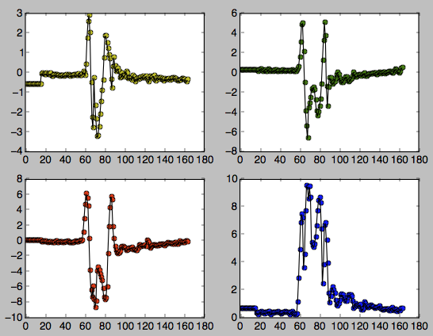
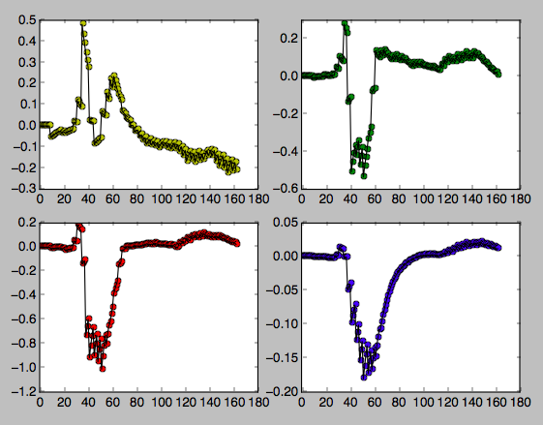
Grip gesture
Issues:
Watch tightness and position variability has a significant effect on the sensor results
High order integrate of sensor value decrease the sensor accuracy dramatically.

Slide 15

Demo 1

Slide 16
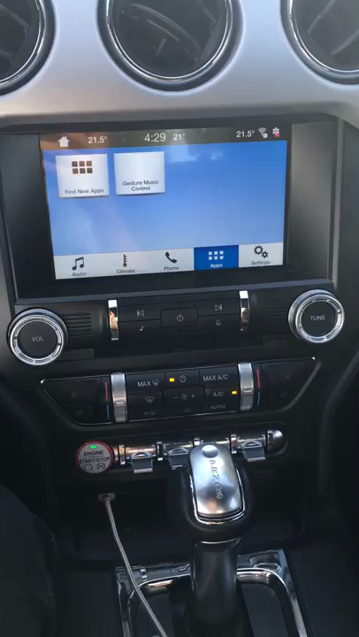
Demo 2

